Slide 1
Proposal Workshop

Slide 2
Today’s Agenda
Potential Outcomes and Causal Inference
Project Workshop

Slide 3
What is causality?
In short: if x hadn’t happened, y wouldn’t have happened.
Not the same as x predicting y.

Slide 4
Potential Outcomes
We compare two states of the world:
Individual is treated
Individual is not treated
In reality, we can only ever observe one outcome
We always lack data on the counterfactual

Slide 5
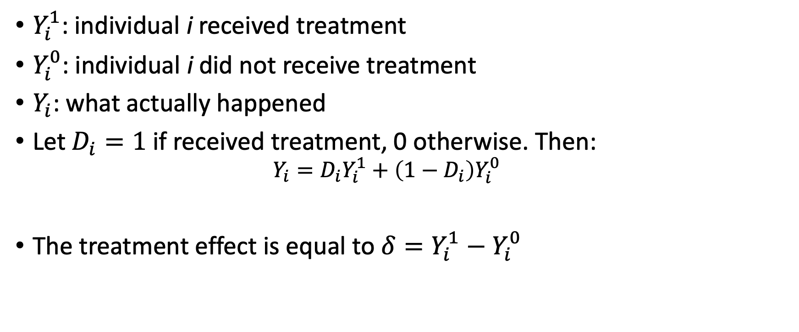
Treatment Effects
$Y_{i}^{1}$: individual i received treatment
$Y_{i}^{0}$: individual i did not receive treatment
$Y_{i}$: what actually happened
Let$D_{i}=1$ if received treatment, 0 otherwise. Then:
$$Y_{i}=D_{i}Y_{i}^{1}+\left(1−D_{i}\right)Y_{i}^{0}$$
The treatment effect is equal to $δ=Y_{i}^{1}−Y_{i}^{0}$

Slide 6
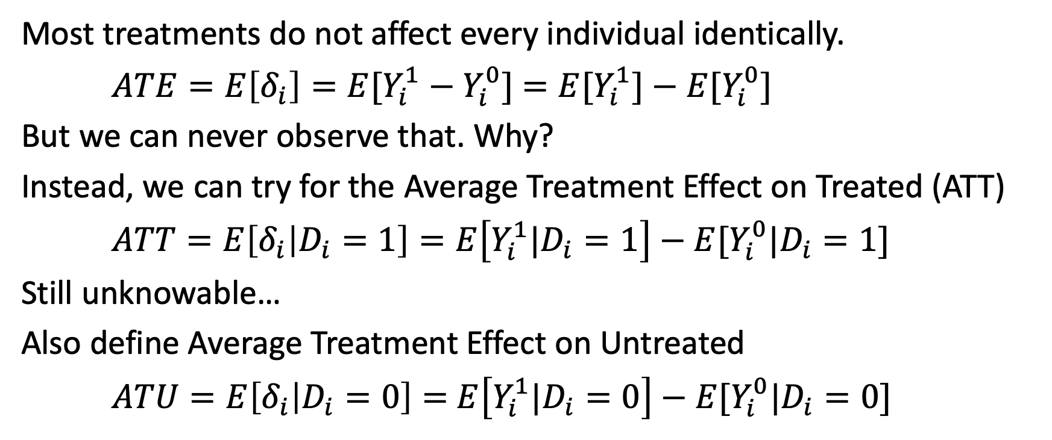
Average Treatment Effects
Most treatments do not affect every individual identically.
$ATE=E\left[δ_{i}\right]=E[Y_{i}^{1}−Y_{i}^{0}]$ $=E[Y_{i}^{1}]−{E[Y}_{i}^{0}]$
But we can never observe that. Why?
Instead, we can try for the Average Treatment Effect on Treated (ATT)
$ATT=E\left[δ_{i} | D_{i}=1\right]=E\left[Y_{i}^{1}|D_{i}=1\right]−{E[Y}_{i}^{0}|D_{i}=1]$
Still unknowable…
Also define Average Treatment Effect on Untreated
$ATU=E\left[δ_{i} | D_{i}=0\right]=$ $E\left[Y_{i}^{1}|D_{i}=0\right]−{E[Y}_{i}^{0}|D_{i}=0]$

Slide 7
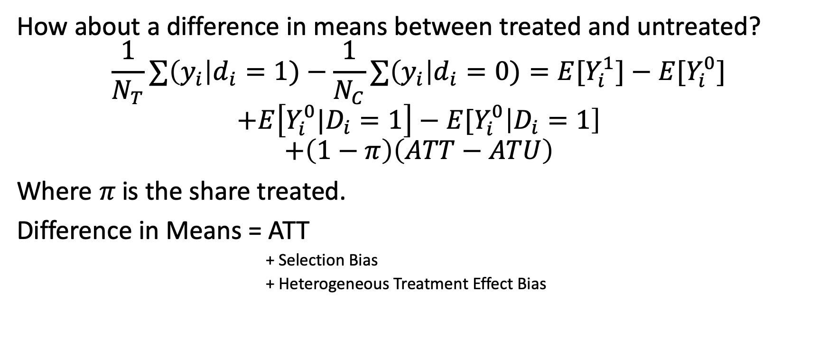
What can we do?
How about a difference in means between treated and untreated?
$$\frac{1}{N_{T}}∑\left(y_{i}\right|d_{i}=1)−\frac{1}{N_{C}}∑\left(y_{i}\right|d_{i}=0)=E[Y_{i}^{1}]−{E[Y}_{i}^{0}]$$
$$+E\left[Y_{i}^{0}|D_{i}=1\right]−{E[Y}_{i}^{0}\left|D_{i}=1\right]$$
$$+\left(1−π\right)\left(ATT−ATU\right)$$
Where $π$is the share treated.
Difference in Means = ATT
+ Selection Bias
+ Heterogeneous Treatment Effect Bias

Slide 8
Identification Problem
We want to eliminate
Selection Bias
Heterogenous Treatment Effect Bias
We tend to focus on the first.

Slide 9
Proposal Workshop

Slide 10
Proposal Workshop
40 min: Create a slide or slide(s) based on your project idea. Begin working on a proposal if you’re ready. Try to be detailed but succinct.
Make your slides here: https://tinyurl.com/692proposal
40 min: In groups of ~4, share your slides with the group. Spend ten minutes discussing each member’s proposal.
10 min: refine your slides for presenting to the class.
After a short break, you’ll each do lightning (~2 min) presentation to the larger class on your idea.
Upload your slide to canvas.

Slide 11
Update your group
Where are you at on choosing a project?
What are your current ideas?
Provide feedback one-by-one. Try to narrow to a single topic.
Which of the following do you think you might include?
Causal Inference
Economic Theory
Where do you think you might find data?

